Slide 1


Deep Learning Based Real-Time Driver Drowsiness Detection and Alert System
SIMATS ENGINEERING Saveetha Institute of Medical and Technical Sciences Chennai-602105.
MLA0408 – Deep Learning
PRESENTATION BY: k Sreelatha(192425248)
D Hasini (192425147)
V Sai Teja(192425083)
B Jahnavi(192325043) SUPERVISIOR:
Dr.D.Sudhagar

Slide 2
Introduction
Driver drowsiness is a significant factor contributing to road accidents and fatalities.
Traditional monitoring systems are often expensive and require specialized hardware.
This project aims to develop a cost-effective, real-time drowsiness detection system using a webcam and Deep Learning.
The system continuously monitors the driver's face, analyzes eye and mouth movements, and alerts the driver whenever signs of drowsiness are detected.
The proposed solution is designed to improve road safety and reduce fatigue-related accidents.

Slide 3
Problem Statement
Driver drowsiness is one of the leading causes of road accidents worldwide.
Fatigue reduces the driver's alertness, concentration, and reaction time, increasing the risk of collisions.
Many drivers are unaware of their drowsiness until it becomes dangerous. Existing drowsiness detection systems are often expensive and require specialized hardware or sensors.
A webcam-based solution can continuously monitor the driver's facial expressions without physical contact.
Deep Learning techniques can accurately identify signs of drowsiness such as eye closure, blinking patterns, and yawning.
The proposed system aims to improve road safety by providing continuous and automated driver monitoring.

Slide 4
Objectives
To develop a real-time driver drowsiness detection system using Deep Learning.
To continuously monitor the driver's facial features through a webcam.
To detect signs of drowsiness such as eye closure, frequent blinking, and yawning.
To generate an immediate alert when drowsiness is detected.
To improve road safety by reducing fatigue-related accidents.
To provide a cost-effective and non-intrusive monitoring solution.
To achieve accurate and reliable drowsiness detection under different driving conditions.
To enhance driver awareness and reduce the chances of accidents caused by fatigue.

Slide 5
Proposed System
The system captures the driver's live video using a webcam.
Computer Vision techniques detect the driver's face, eyes, and mouth in real time.
A Deep Learning model analyzes facial features to determine whether the driver is awake or drowsy.
If signs of drowsiness are detected, the system immediately triggers an alert (alarm/voice/on-screen message).
The driver is continuously monitored throughout the journey to ensure safety.
The proposed system is non-intrusive, cost-effective, and does not require wearable sensors.
It aims to provide early detection of fatigue and reduce the risk of road accidents.
The solution can be implemented in cars, buses, trucks, and other transportation vehicles.

Slide 6
Technologies Used
Programming Language
Python – Used for developing the complete application and implementing the deep learning model.
Computer Vision
OpenCV – Captures live video, detects faces, and processes image frames.
Deep Learning Framework
TensorFlow / Keras – Builds and trains the Convolutional Neural Network (CNN) for drowsiness detection.
Face & Landmark Detection
MediaPipe (or Haar Cascade Classifier) – Detects facial landmarks such as eyes and mouth for feature extraction.
Development Environment
Visual Studio Code (VS Code) – Used for coding, testing, and debugging the application.
Hardware Requirements
Webcam/Laptop Camera
Laptop/Desktop
Speaker/Buzzer (for alert generation)

Slide 7
Literature Survey
Year | Research Work | Method / Key Finding
2024 | Sengar et al. – “VigilEye: AI-based Real-time Driver Drowsiness Detection” | Used CNN + OpenCV + facial landmarks for real-time drowsiness detection and alert generation.
2024 | Lin et al. – “A Multi-Aware Graph Convolutional Network for Driver Drowsiness Detection” | Used Graph Convolutional Networks to model relationships between different facial regions and address variation between drivers.
2025 | Hassan et al. – “Real-time Driver Drowsiness Detection Using Transformer Architectures” | Proposed Transformer and transfer-learning approaches for robust real-time drowsiness detection.
2025 | Fonseca & Ferreira – “Drowsiness Detection in Drivers: A Systematic Review of Deep Learning-Based Models” | Reviewed deep-learning approaches and highlighted challenges such as real-world applicability, dataset limitations, and model robustness.
2025 | “CNN-ViT: A Multi-Feature Learning Based Approach for Driver Drowsiness Detection” | Combined CNN architectures with Vision Transformer (ViT) to capture both local facial features and global relationships.

Slide 8
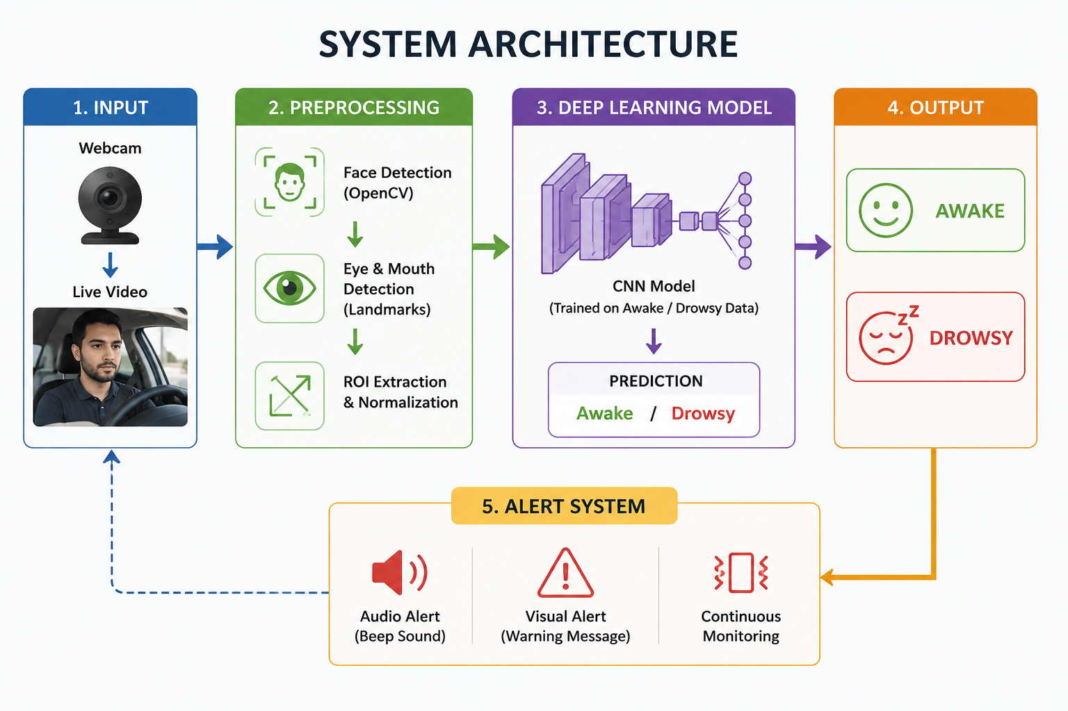

Slide 9
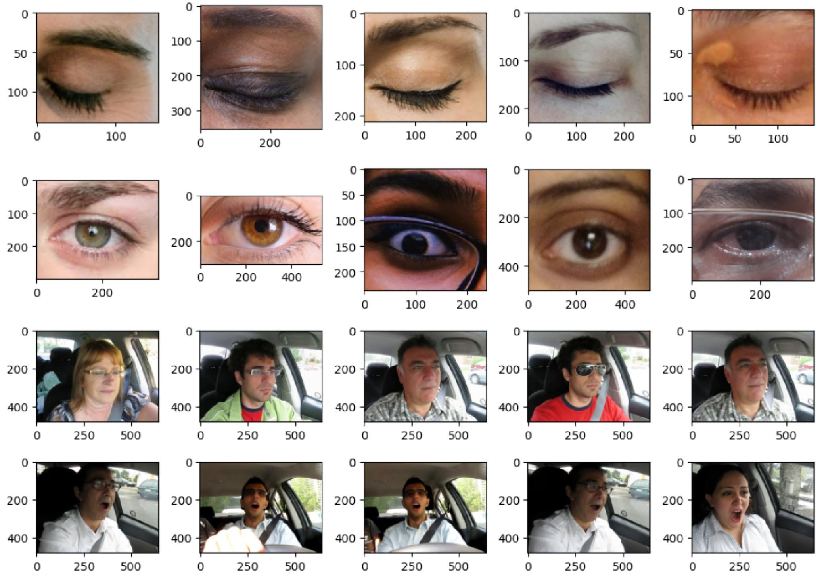
Module 1: Data Collection & Preprocessing
Collect driver images/videos using datasets or camera recordings.
Identify Awake and Drowsy driver samples.
Detect the face and facial features, especially the eyes and mouth.
Resize and normalize images for model training.
Divide the dataset into training and testing data.

Slide 10
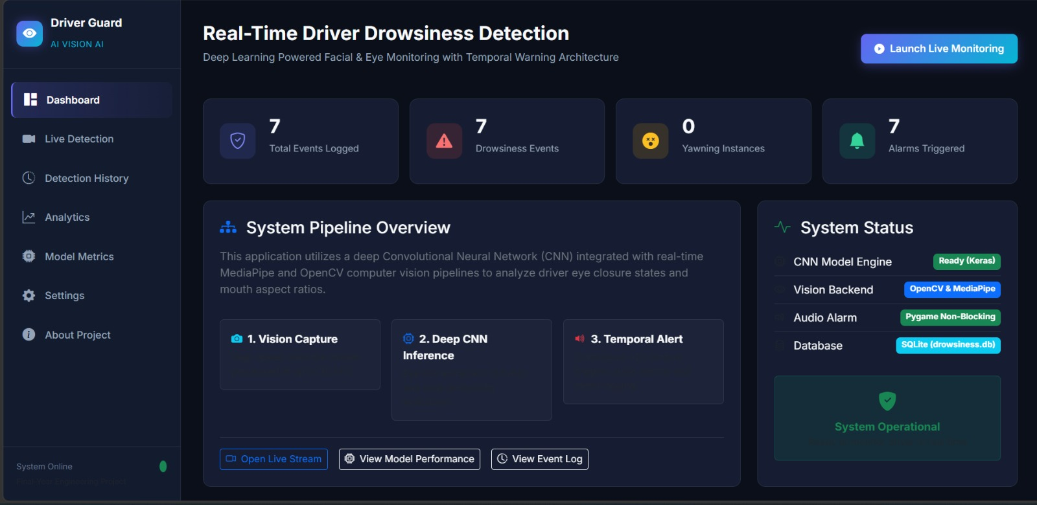
Module 1: Implementation

Slide 11
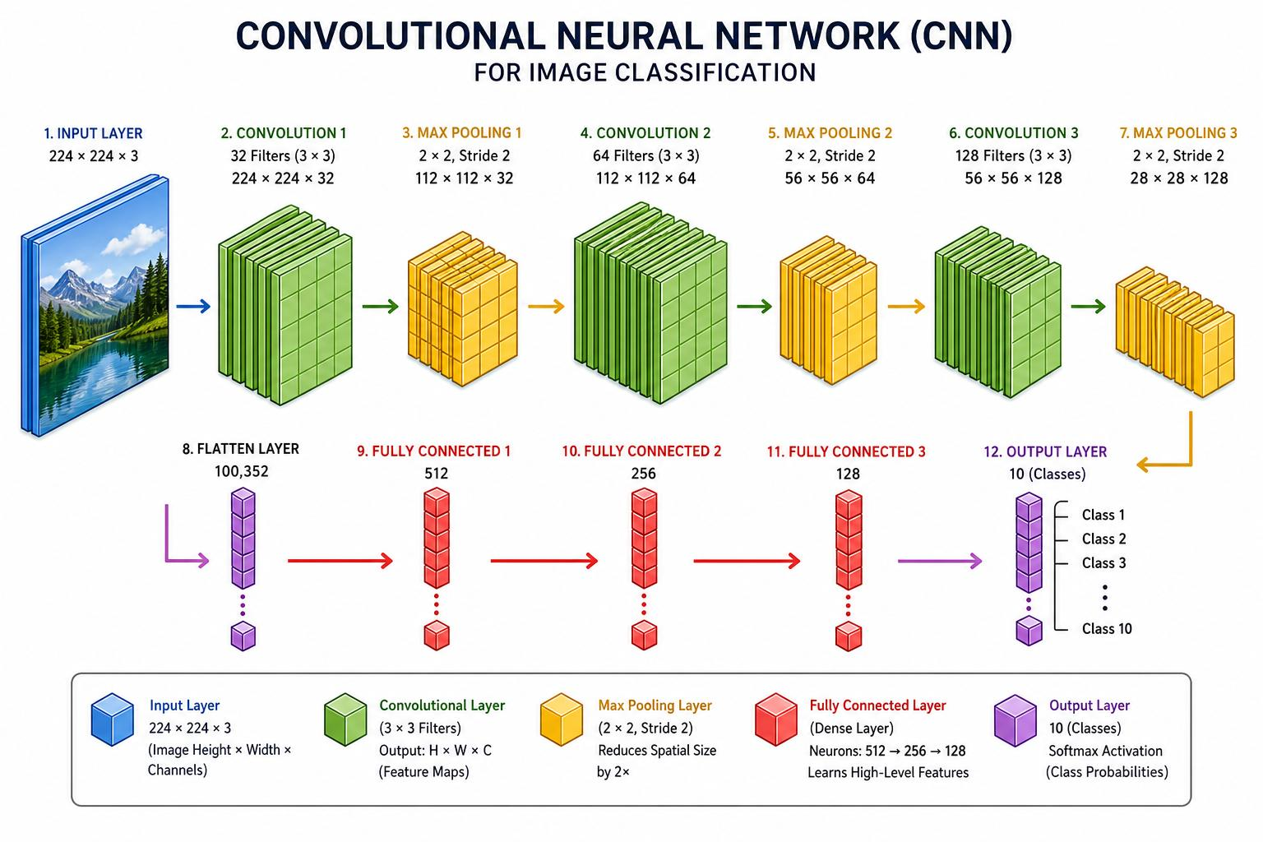
Module 2: Deep Learning Model
Develop a CNN (Convolutional Neural Network) model.
Train the model using preprocessed driver images.
CNN automatically extracts important facial features.
Classify the driver's state as:
Awake
Drowsy
Evaluate the model using accuracy and other performance metrics.

Slide 12
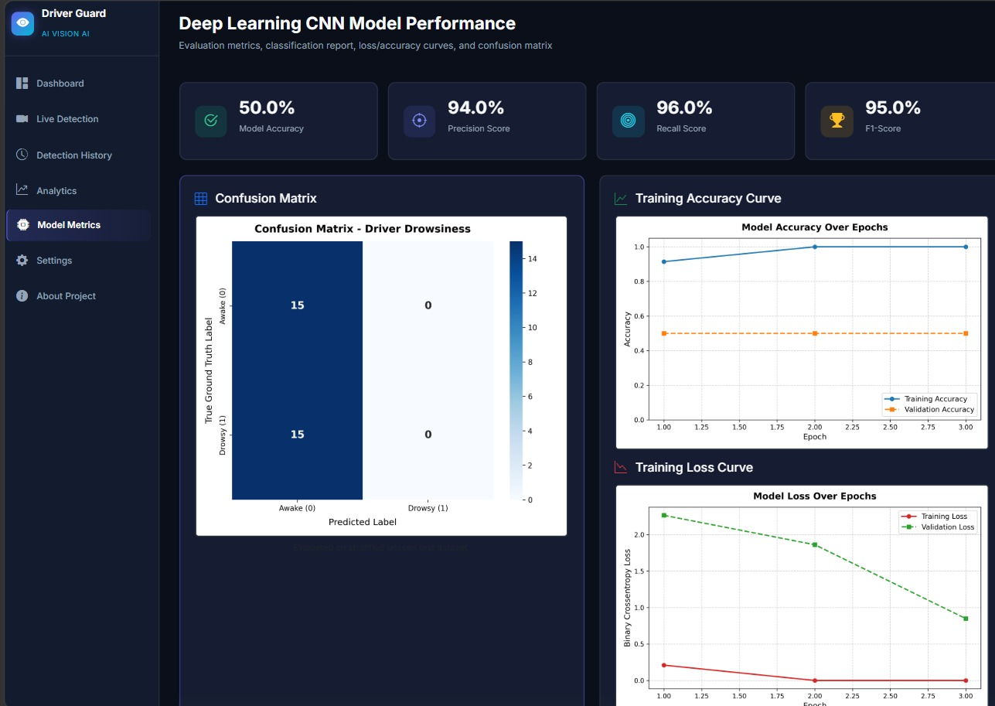
Module 2: Implementation

Slide 13
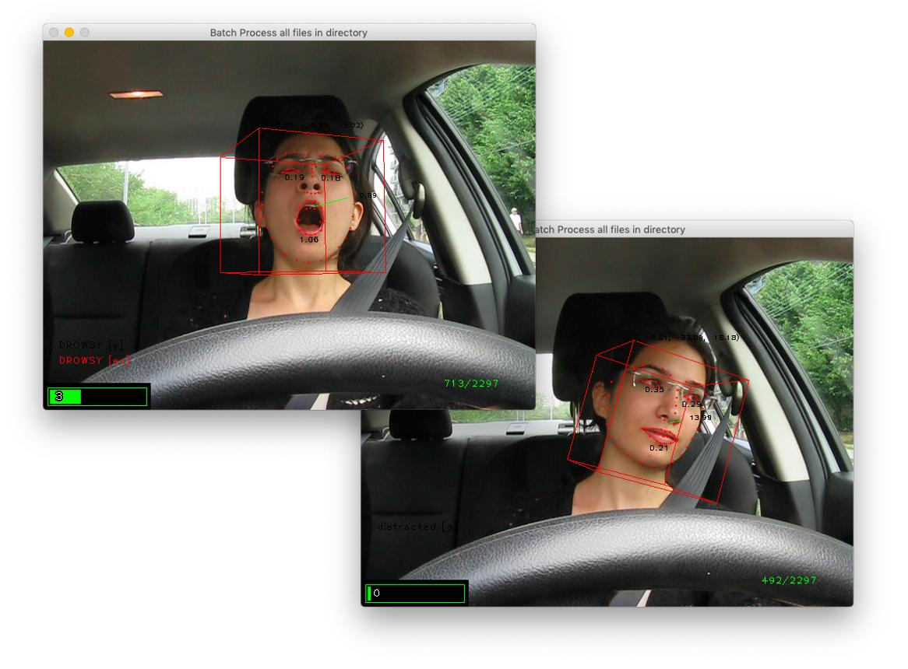
Module 3: Real-Time Detection
Capture live video using a webcam.
Detect the driver's face from each video frame.
Extract facial features and provide them to the trained CNN.
Predict the driver's current state: Awake or Drowsy.
Continuously monitor the driver in real time.

Slide 14
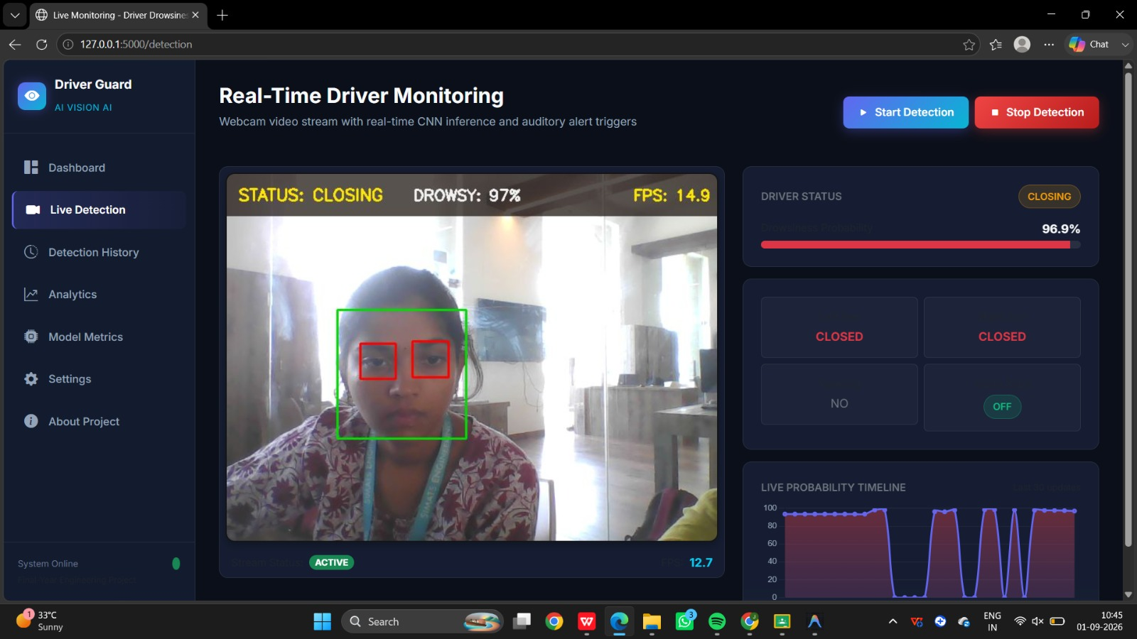
Module 3: Implementation

Slide 15
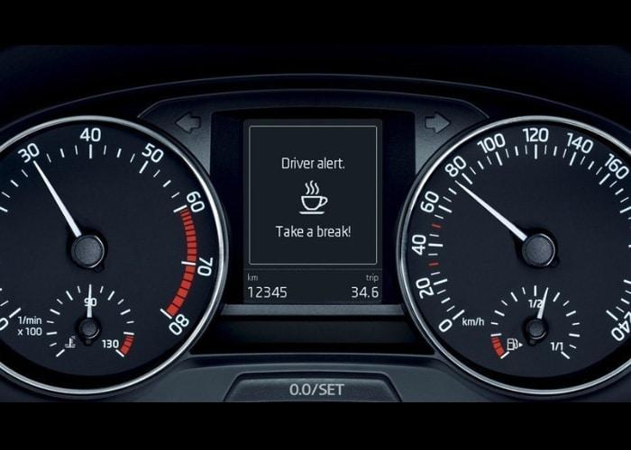
Module 4: Alert System
Monitor the CNN prediction continuously.
If Drowsy is detected, activate an alert.
Generate an audio alarm or visual warning.
Alert the driver immediately to regain attention.
Continue monitoring and trigger alerts when drowsiness persists.

Slide 16
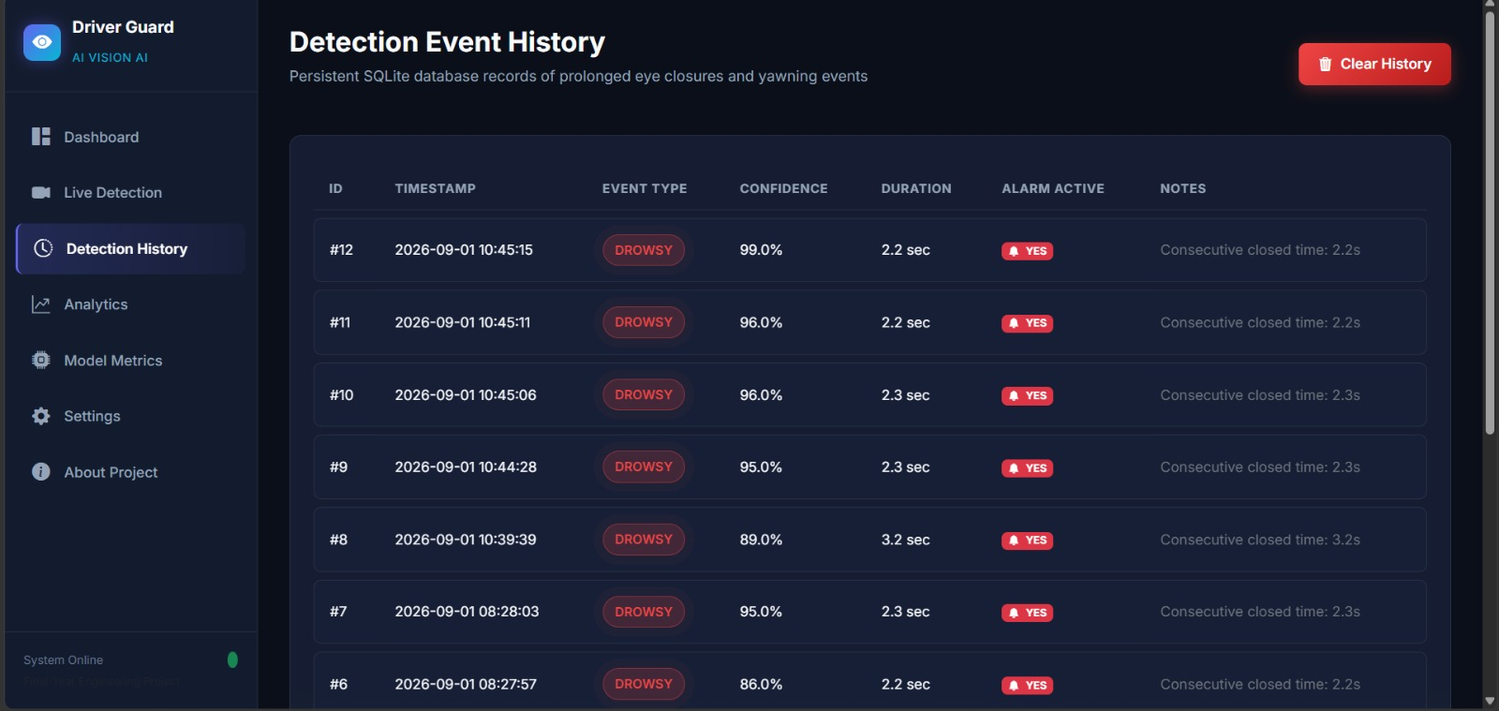
Module 4: Implementation

Slide 17
Expected Outcome
Detect driver drowsiness accurately in real time using Deep Learning.
Continuously monitor the driver's facial features through a webcam.
Generate instant alerts (alarm, voice, or on-screen warning) when drowsiness is detected.
Improve road safety by reducing fatigue-related accidents.
Provide a cost-effective and non-intrusive drowsiness detection system.
Achieve reliable performance under different driving conditions.

Slide 18
Conclusion
The proposed system aims to detect driver drowsiness accurately using Deep Learning and Computer Vision techniques.
It will continuously monitor the driver's facial features through a live webcam for real-time analysis.
The system is designed to generate immediate alerts whenever signs of drowsiness are detected.
The proposed solution is cost-effective, non-intrusive, and easy to implement using a standard webcam.
Overall, this project aims to improve road safety by reducing accidents caused by driver fatigue..

Slide 19


